Slide 1

Object Detection
Image Detection
Name: Sameer Aqib Hashmi
ID: 1520180642

Slide 2
Machine Learning
01
Image Dataset
02
CNN
03
04
TensorFlow-Gpu
Anaconda(Jupyter Notebook)

Slide 3

TensorFlow
TensorFlow is the second machine learning framework that Google created and used to design, build, and train deep learning models. You can use the TensorFlow library do to numerical computations, which in itself doesn’t seem all too special, but these computations are done with data flow graphs. In these graphs, nodes represent mathematical operations, while the edges represent the data, which usually are multidimensional data arrays or tensors, that are communicated between these edges.

Slide 4
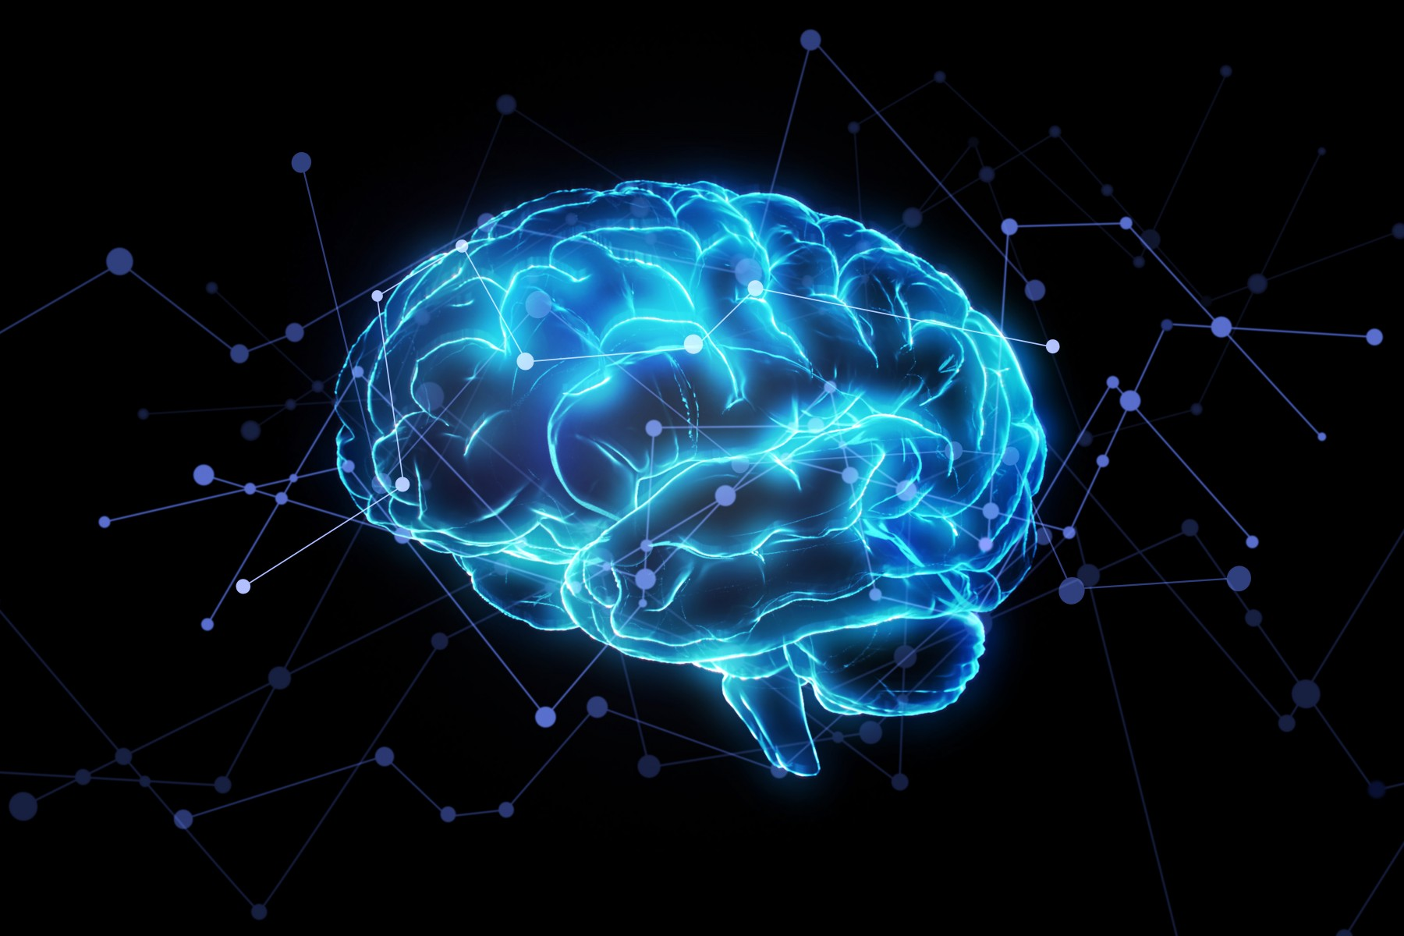
CNN
Convolutional Neural Network
Deep learning is a subfield of machine learning that is a set of algorithms that is inspired by the structure and function of the brain.
In machine learning, Convolutional Neural Networks (CNN or ConvNet) are complex feed forward neural networks. CNNs are used for image classification and recognition because of its high accuracy. It was proposed by computer scientist Yann LeCun in the late 90s, when he was inspired from the human visual perception of recognizing things. The CNN follows a hierarchical model which works on building a network, like a funnel, and finally gives out a fully-connected layer where all the neurons are connected to each other and the output is processed.

Slide 5
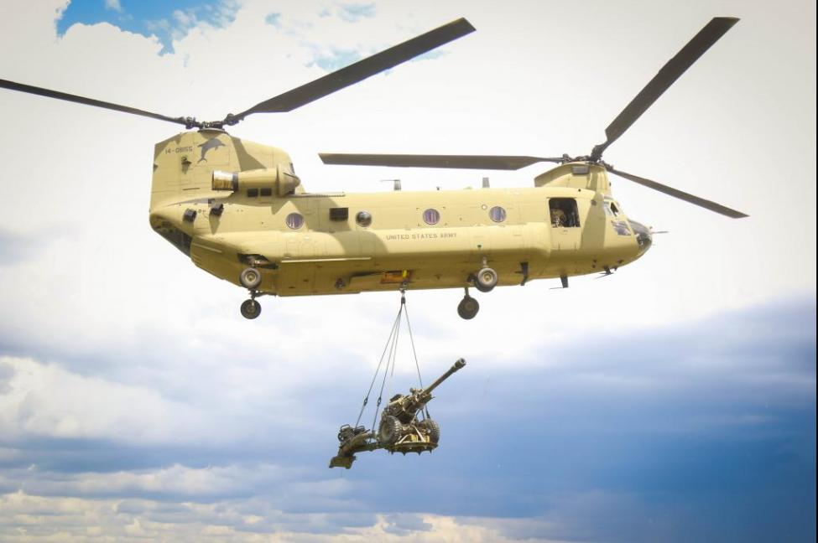
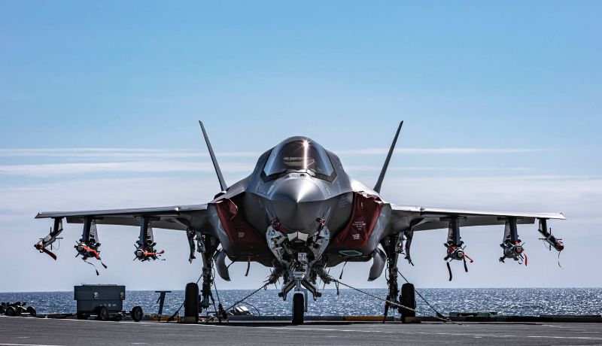
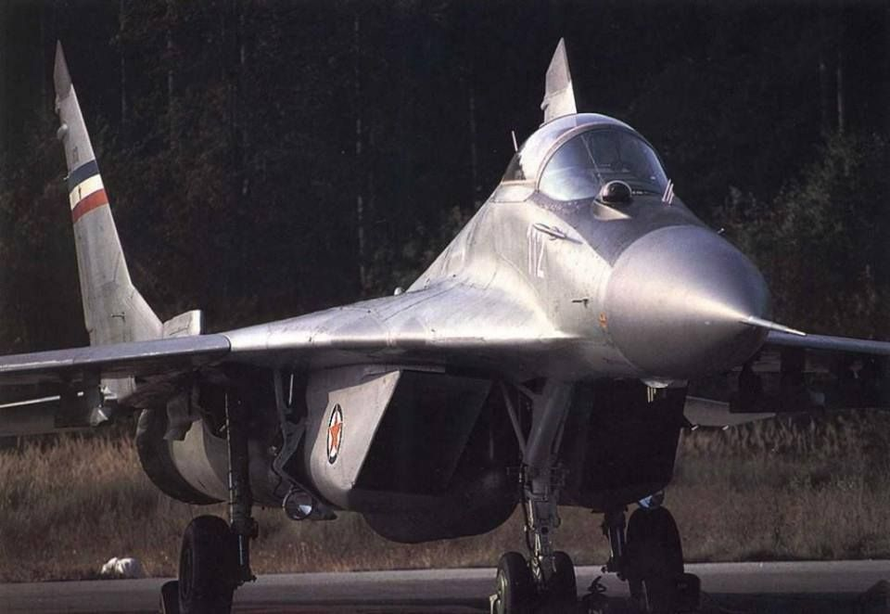
Dataset
Chinook
F-35 Lightning
I've taken 130 pictures of Chinook Helicopter
pictures are being splited 130 for training and 70 for testing
MiG-29
200 pictures have been taken

Slide 6
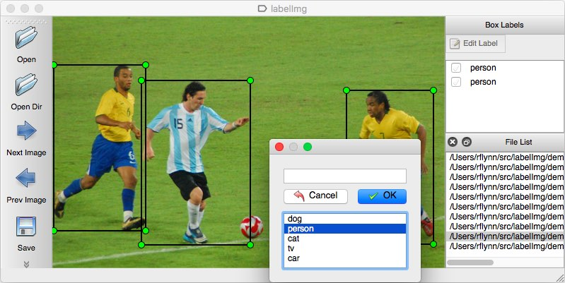
Image Labeling
using labelImg https://github.com/tzutalin/labelImg unzip labelImg
run cmd and went to labelImg dir

Slide 7
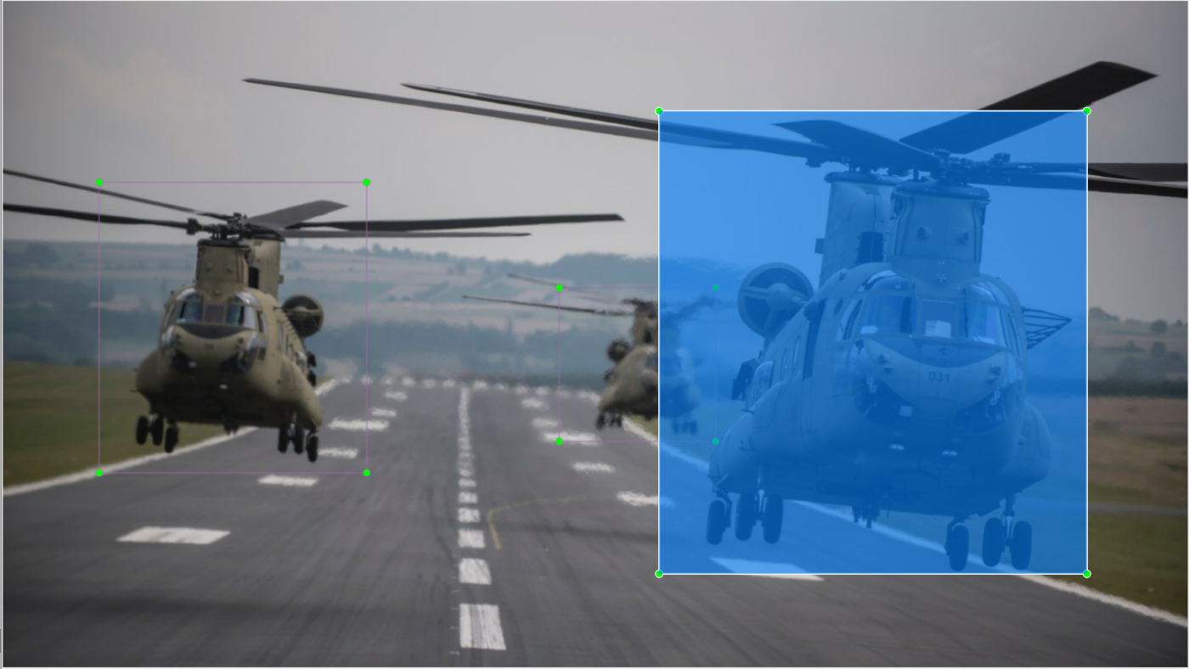
Image Labeling
More than 500 images are being labeled to make dataset

Slide 8

Anaconda
Anaconda is popular because it brings many of the tools used in data science and machine learning with just one install, so it's great for having short and simple setup. Like Virtualenv, Anaconda also uses the concept of creating environments so as to isolate different libraries and versions
Anaconda python is faster than vanilla python...

Slide 9
Works
Installed TensorFlow-GPU
Created virtual environment
other necessary packages
(tensorflow1) C:\> conda install -c anaconda protobuf
(tensorflow1) C:\> pip install pillow
(tensorflow1) C:\> pip install lxml
(tensorflow1) C:\> pip install Cython
(tensorflow1) C:\> pip install jupyter
(tensorflow1) C:\> pip install matplotlib
(tensorflow1) C:\> pip install pandas
(tensorflow1) C:\> pip install opencv-python
pip install --upgrade tensorflow-gpu
conda create -n tensorflow1 pip python=3.5
activate tensorflow1
pip install --ignore-installed --upgrade tensorflow-gpu

Slide 10
Works
https://github.com/tensorflow/models/blob/master/research/object_detection/g3doc/detection_model_zoo.md
https://github.com/tensorflow/models
Downloaded the full TensorFlow object detection repository
Downloaded faster_rcnn_inception_v2_coco

Slide 11
Works
Configured environment variable
every time to run the project must add this lines
Configured PYTHONPATH environment variable
PYTHONPATH variable must be created that points to the directories \models
\models\research
\models\research\slim
set PYTHONPATH = C:\tensorflow1\models;C:\tensorflow1\models\research;C:\tensorflow1\models\research\slim
echo %PYTHONPATH%
set PATH=%PATH%;PYTHONPATH
echo %PATH%

Slide 12
Works
protoc --python_out=. .\object_detection\protos\anchor_generator.proto .\object_detection\protos\argmax_matcher.proto .\object_detection\protos\bipartite_matcher.proto .\object_detection\protos\box_coder.proto .\object_detection\protos\box_predictor.proto .\object_detection\protos\eval.proto .\object_detection\protos\faster_rcnn.proto .\object_detection\protos\faster_rcnn_box_coder.proto .\object_detection\protos\grid_anchor_generator.proto .\object_detection\protos\hyperparams.proto .\object_detection\protos\image_resizer.proto .\object_detection\protos\input_reader.proto .\object_detection\protos\losses.proto .\object_detection\protos\matcher.proto .\object_detection\protos\mean_stddev_box_coder.proto .\object_detection\protos\model.proto .\object_detection\protos\optimizer.proto .\object_detection\protos\pipeline.proto .\object_detection\protos\post_processing.proto .\object_detection\protos\preprocessor.proto .\object_detection\protos\region_similarity_calculator.proto .\object_detection\protos\square_box_coder.proto .\object_detection\protos\ssd.proto .\object_detection\protos\ssd_anchor_generator.proto .\object_detection\protos\string_int_label_map.proto .\object_detection\protos\train.proto .\object_detection\protos\keypoint_box_coder.proto .\object_detection\protos\multiscale_anchor_generator.proto .\object_detection\protos\graph_rewriter.proto
Compiled Protobufs
Protobuf (Protocol Buffers) libraries must be compiled , it used by TensorFlow to configure model and training parameters Open Anaconda Prompt and go to C:\tensorflow1\models\research
(tensorflow1) C:\tensorflow1\models\research> python setup.py build
(tensorflow1) C:\tensorflow1\models\research> python setup.py install

Slide 13
Works
Tested TensorFlow setup
Generated Training Data
This creates a train_labels.csv and test_labels.csv file in the \object_detection\images folder.
python generate_tfrecord.py --csv_input=images\train_labels.csv --image_dir=images\train --output_path=train.record
TFRecords is an input data to the TensorFlow training model creat .csv files from .xml files
Tested TensorFlow setup to verify it works (tensorflow1) C:\tensorflow1\models\research\object_detection> jupyter notebook object_detection_tutorial.ipynb
cd C:\tensorflow1\models\research\object_detection
python xml_to_csv.py
python generate_tfrecord.py --csv_input=images\test_labels.csv --image_dir=images\test --output_path=train.record

Slide 14
Works
Edited generate_tfrecord.py
Created a label map and edit the training configuration file.
went to \data copy pet_label_map.pbtxt to \training dir and rename it to labelmap.pbtxt
edited it to the class chinook
Configured object detection tranning pipelines

Slide 15
Works
Runned the training
Tensorboard
Exported Inference Graph
training is complete ,the last step is to generate the frozen inference graph (.pb file) change “XXXX” in “model.ckpt-XXXX” should be replaced with the highest-numbered .ckpt file in the training folder:
python export_inference_graph.py --input_type image_tensor --pipeline_config_path training/faster_rcnn_inception_v2_pets.config --trained_checkpoint_prefix training/model.ckpt-XXXX --output_directory inference_graph
python train.py --logtostderr --train_dir=training/ --pipeline_config_path=training/faster_rcnn_inception_v2_pets.config
in cmd (tensorflow1) C:\tensorflow1\models\research\object_detection>tensorboard --logdir=training

Slide 16
Let's Start Detecting Images of Chinook

Slide 17
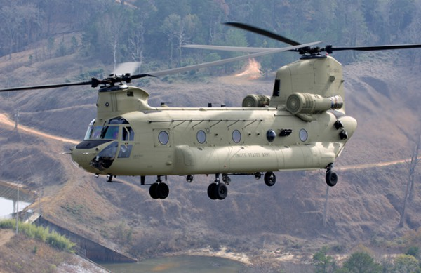
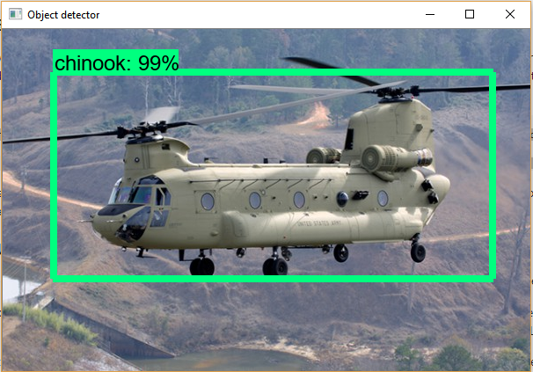
In
Out
This PPT template for the rice husk designer pencil demo works, focusing on the production of high-end design husk designer pencil dem

Slide 18
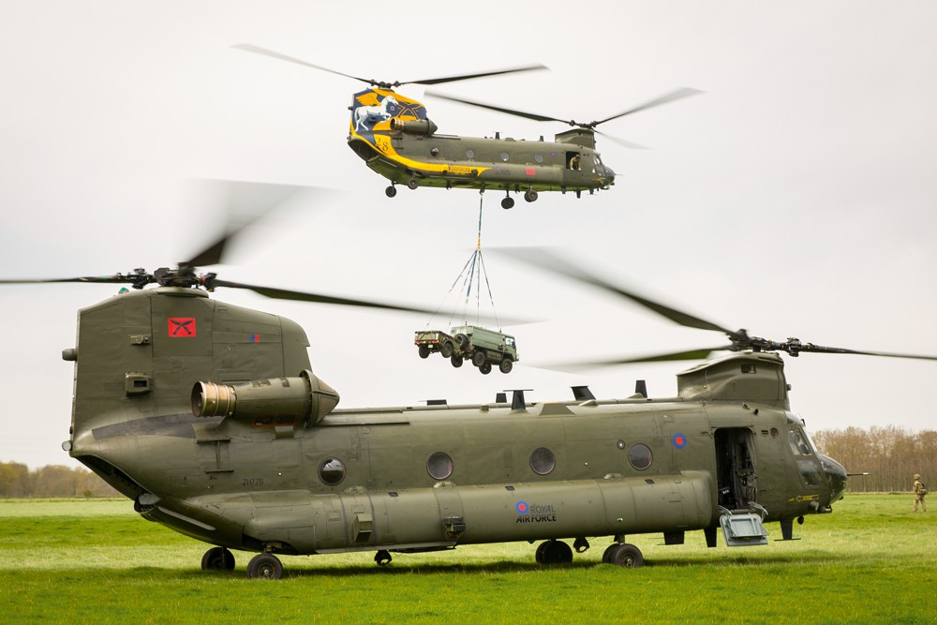
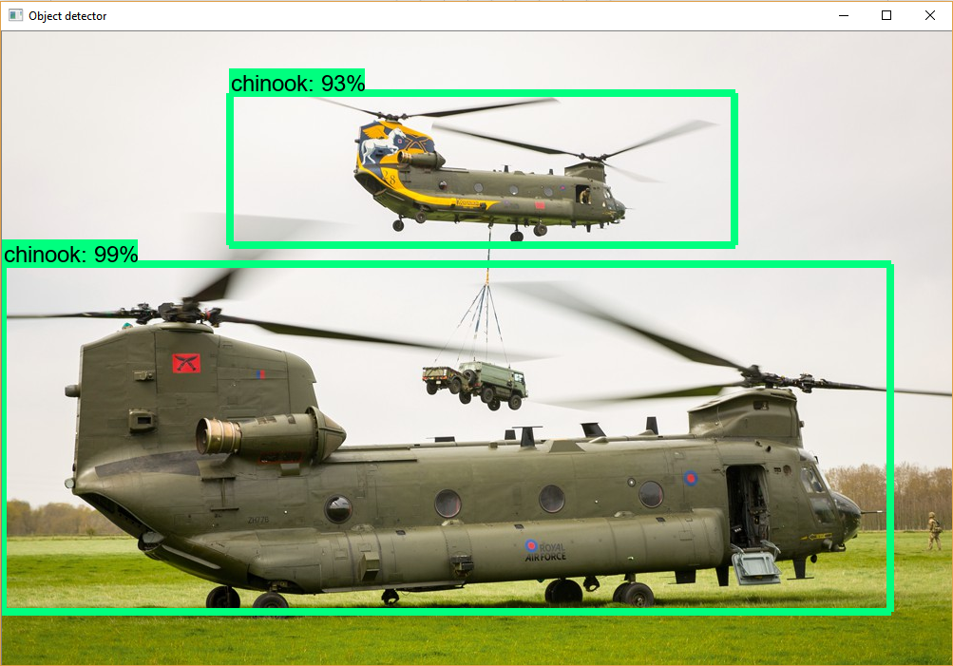
In
Out
This PPT template for the rice husk designer pencil demo works, focusing on the production of high-end design husk designer pencil dem

Slide 19
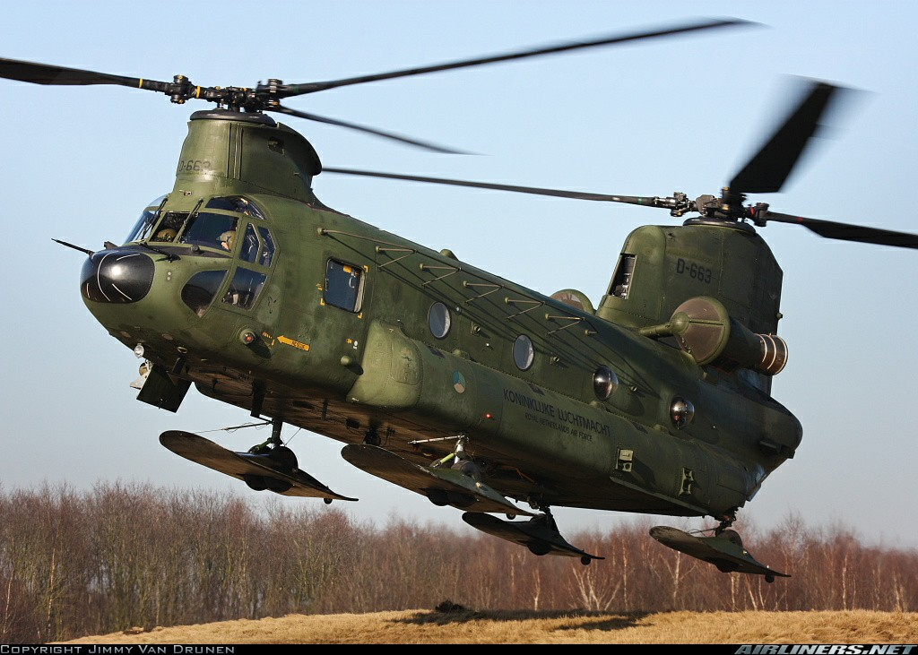
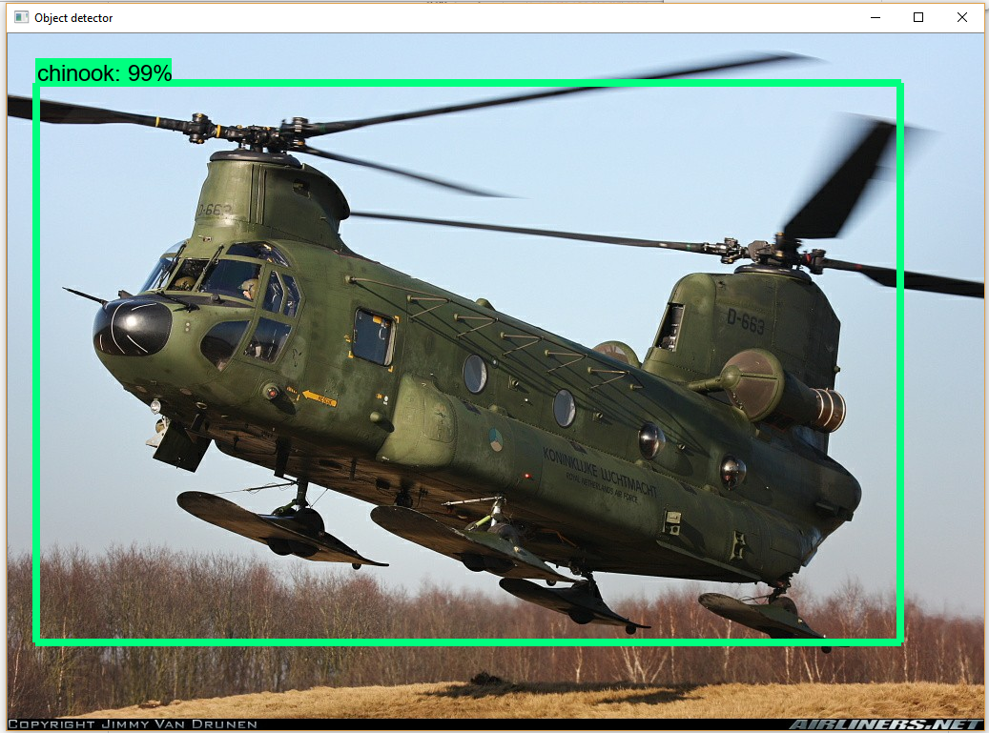
In
Out
This PPT template for the rice husk designer pencil demo works, focusing on the production of high-end design husk designer pencil dem

Slide 20
THANK YOU
12.23.19

